Slide 1
Keyed Hash Functions as MACs
Used to create a MAC using a hash function rather than a block cipher( Eg., DAA used DES)
because hash functions are generally faster
not limited by export restrictions unlike block ciphers
led to development of HMAC

Slide 2
HMAC
uses hash function on the message:
HMAC_{K} = Hash[(K⁺ XOR opad) ||
Hash[(K⁺ XOR ipad)|| M )]]
where K⁺ is the secret key K padded with 0’s on the left to increase size to b bits (512 bits in MD5)
opad, ipad are padding constants
ipad= 00110110 repeated b/8 times (64 times in MD5)
Opad=01011100 repeated b/8 times (64 times in MD5)
overhead is hash calculations of just 3 more blocks (Si, So, block produced from inner hash).
any of MD5, SHA-1, RIPEMD-160 can be used
Notes:
The idea of a keyed hash evolved into HMAC, designed to overcome some problems with the original proposals. Further have a design that has been shown to have the same security as the underlying hash alg. The hash function need only be used on 3 more blocks than when hashing just the original message (for the two keys + inner hash). Choose hash alg to use based on speed/security concerns.

Slide 3
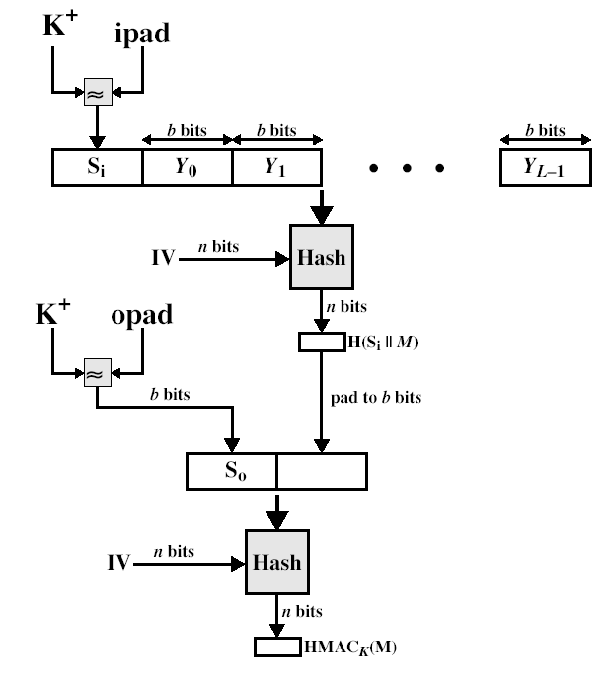
HMAC Overview
⊕
⊕

Slide 4
HMAC algorithm
Assume that hash function operates on a block of size = b bits (Eg., 512 bits in MFD5)
Select a key K
Generate K⁺ by prepending zeros to K, (to make size of K⁺ = b bits)
Calculate Si= K⁺ ⊕ ipad, So= K⁺ ⊕ opad
Prepend Si with message M => Si II M
Generate H( Si II M ) and pad to b bits, call it H1
Generate H( So II H1 ) which is HMAC_{k}(M)

Slide 5
Efficient implementation of HMAC
Since S_{i} and S₀ uses only key and does not depend on the message, they remain constant for all messages, if key is not changed
So we can precompute S_{i} and S₀ and their hash values and reuse them for new messages to speed up the process.

Slide 6
i.e., To speed up the process by precomputing
S_{i} and S₀ which do not change when the messages are changing and can be used for all new messages without recomputing them as long as the key is not changed
Hash(Si) and Hash(S0)
S_{i} and S₀ and subsequently Hash(Si) and Hash(S0) will be recalculated whenever we change the keys.

Slide 7
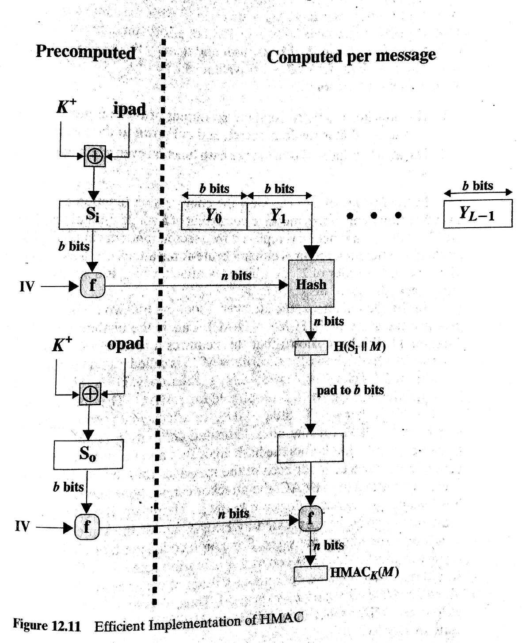

Slide 8
HMAC Security
Security of HMAC is given by the security of the underlying hash algorithm
attacking HMAC requires either:
brute force attack on key used
birthday attack (but need to observe a very large number of messages)

